Slide 1
Causal Inference Crash Course Part 4: Best Practices: Outliers, Class Imbalance, Feature Selection, and Bad Control
Julian Hsu

Slide 2
Causal Inference Series
Foundations
Defining Some ATE/ATET Causal Models
ATE/ATET Inference, Asymptotic Theory, and Bootstrapping
Best Practices: Outliers, Feature Selection, Bad Control, and Propensity Trimming
Heterogeneous Treatment Effect Models and Inference
Difference-in-Difference Models for Panel Data
Regression Discontinuity Models
Arguable Validation

Slide 3
Overview
This presentation will outline best practices for issues around causal inference which can be applied to other ML settings.
Outliers;
Feature Selection;
Bad Control ; and
Propensity Score Trimming
For each issue, we will discuss what the problem is, why it’s a problem, and a solution outline.

Slide 4
A. Outliers

Slide 5
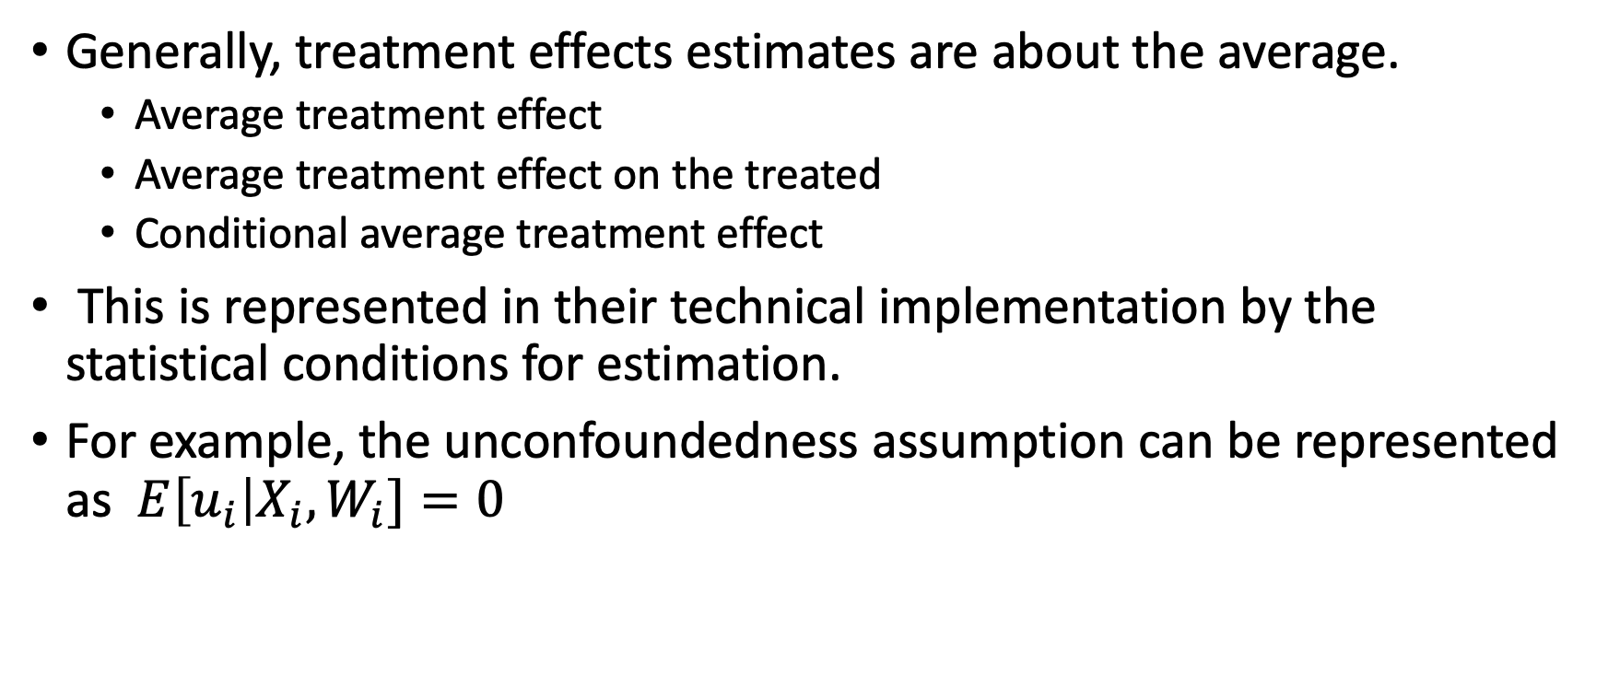
Why are outliers problems?
Generally, treatment effects estimates are about the average.
Average treatment effect
Average treatment effect on the treated
Conditional average treatment effect
This is represented in their technical implementation by the statistical conditions for estimation.
For example, the unconfoundedness assumption can be represented as $E\left[u_{i}\right|X_{i}, W_{i}]=0$

Slide 6
Outliers skew the average
Obviously, outlier values cause the average to take on extreme values
This is also a theoretical problem because we have already decided our metric of interest is the average. The average by its nature is sensitive to outliers.
The median not so much, but we’ll return to the median later.
Outliers can be a problem if the data is is meant to be representative, but we still have low sample size.

Slide 7
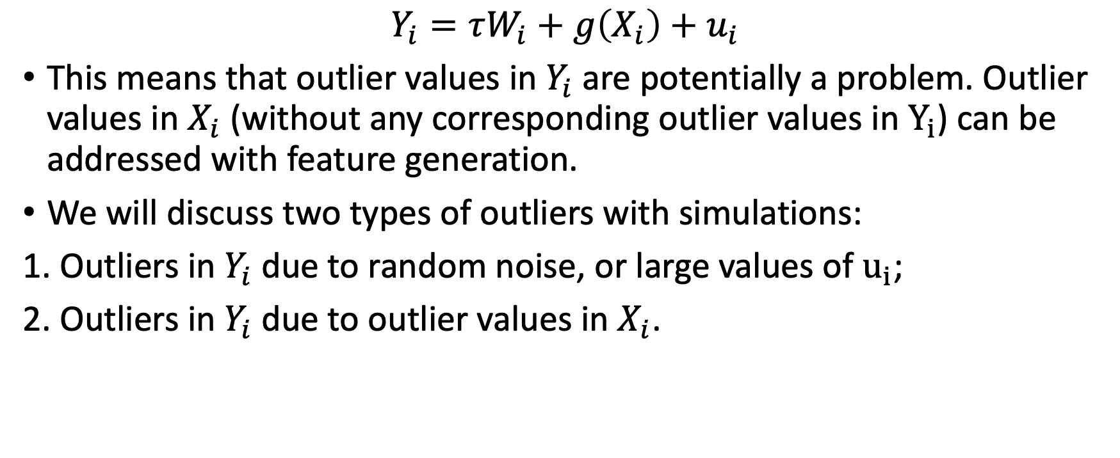
Two types of outliers
$$Y_{i}=τW_{i}+g\left(X_{i}\right)+u_{i}$$
This means that outlier values in $Y_{i}$are potentially a problem. Outlier values in $X_{i}$ (without any corresponding outlier values in $Y_{i}$) can be addressed with feature generation.
We will discuss two types of outliers with simulations:
1. Outliers in $Y_{i}$ due to random noise, or large values of $u_{i}$;
2. Outliers in $Y_{i}$ due to outlier values in $X_{i}$.

Slide 8
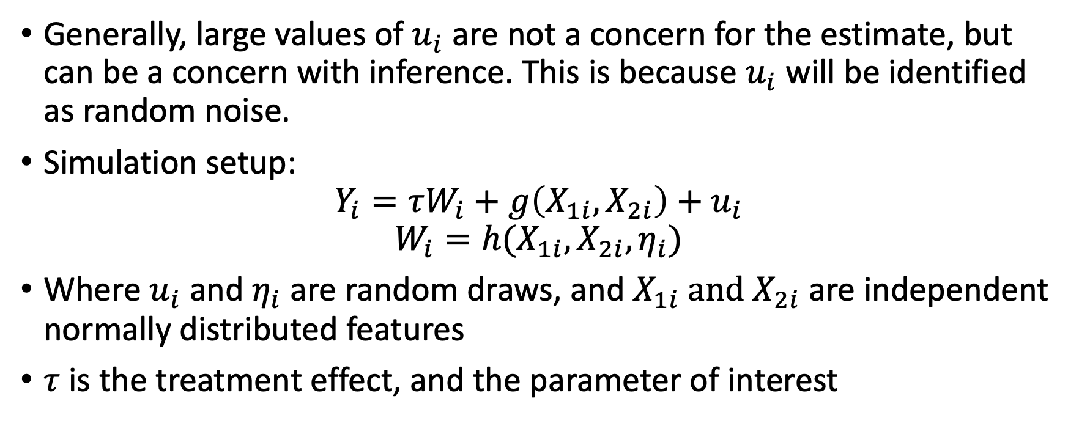
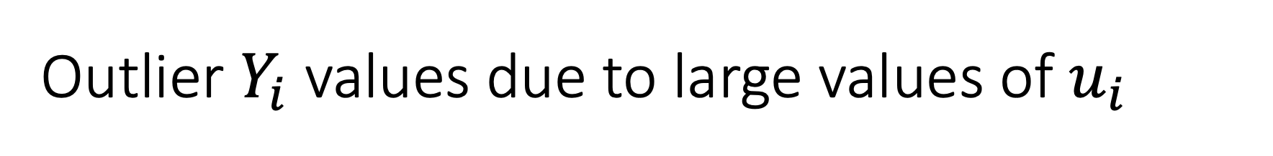
Outlier $Y_{i}$ values due to large values of $u_{i}$
Generally, large values of $u_{i}$ are not a concern for the estimate, but can be a concern with inference. This is because $u_{i}$ will be identified as random noise.
Simulation setup:
$$Y_{i}=τW_{i}+g\left(X_{1i},X_{2i}\right)+u_{i}$$
$$W_{i}=h(X_{1i}, X_{2i}, η_{i})$$
Where $u_{i}$ and$η_{i}$ are random draws, and $X_{1i} \text{and} X_{2i}$ are independent normally distributed features
$τ$ is the treatment effect, and the parameter of interest

Slide 9
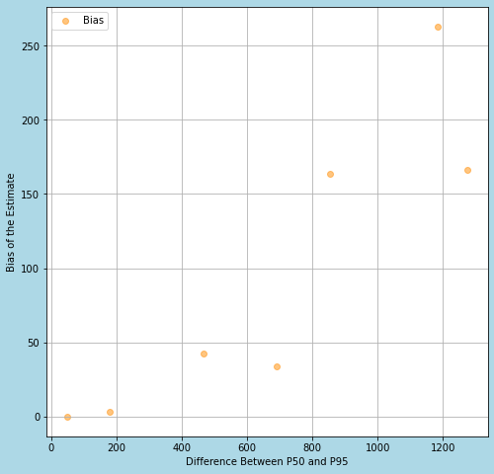
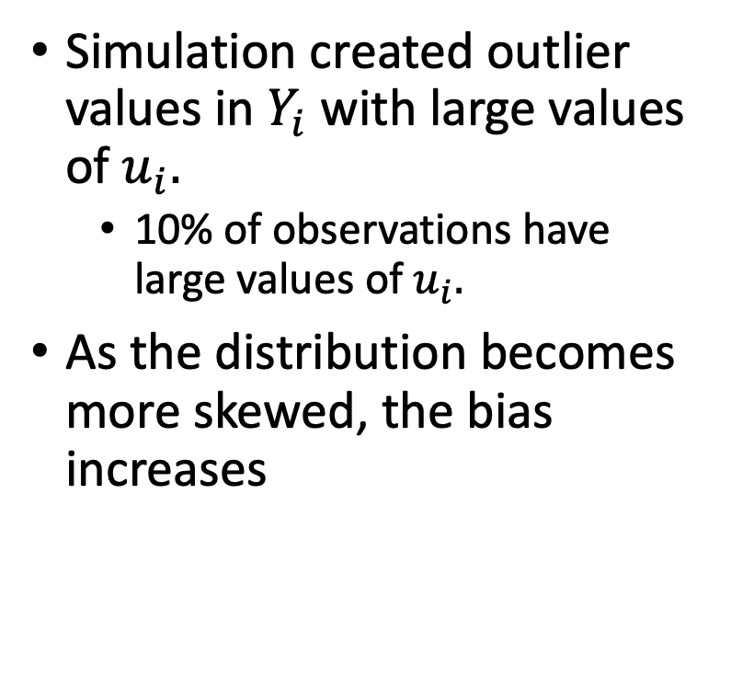
Simulation evidence
Simulation created outlier values in $Y_{i}$ with large values of $u_{i}.$
10% of observations have large values of $u_{i}.$
As the distribution becomes more skewed, the bias increases

Slide 10
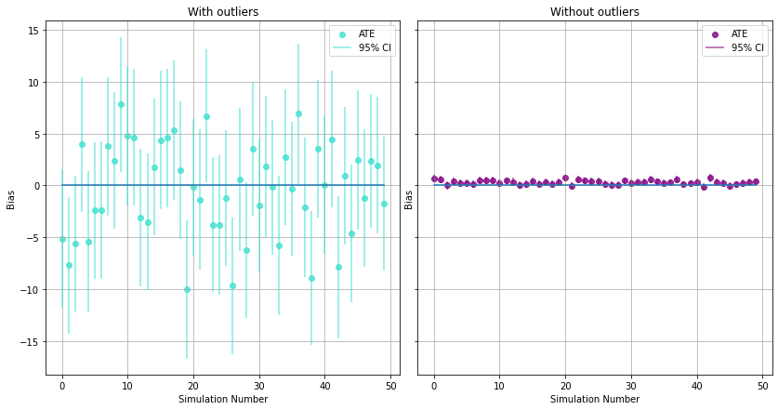
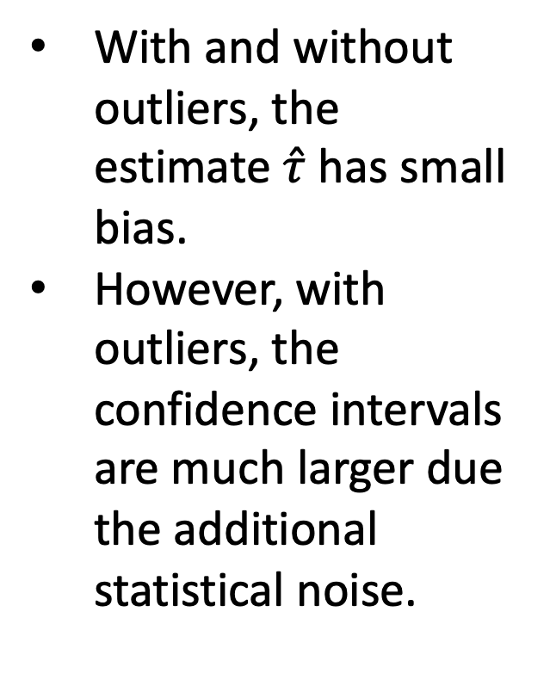
Simulation results on the bias
With and without outliers, the estimate $\hat{τ}$ has small bias.
However, with outliers, the confidence intervals are much larger due the additional statistical noise.

Slide 11
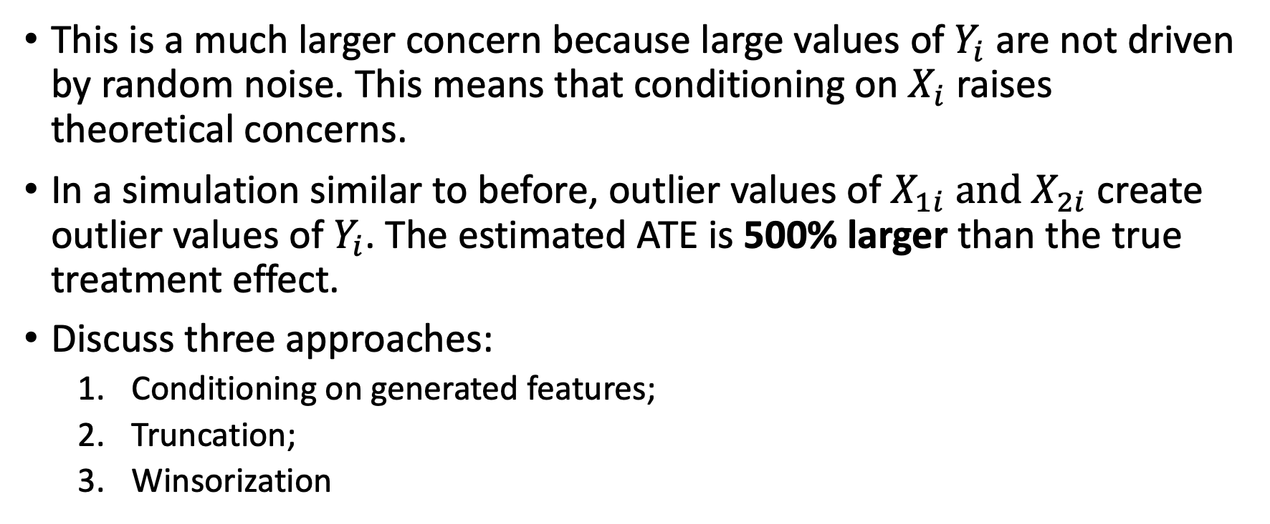
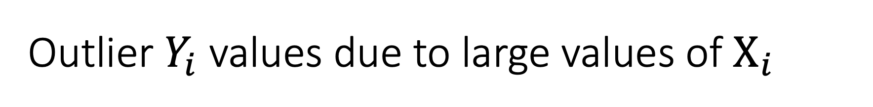
Outlier $Y_{i}$ values due to large values of $X_{i}$
This is a much larger concern because large values of $Y_{i}$ are not driven by random noise. This means that conditioning on $X_{i}$raises theoretical concerns.
In a simulation similar to before, outlier values of $X_{1i} \text{and} X_{2i}$ create outlier values of $Y_{i}$. The estimated ATE is 500% larger than the true treatment effect.
Discuss three approaches:
Conditioning on generated features;
Truncation;
Winsorization

Slide 12
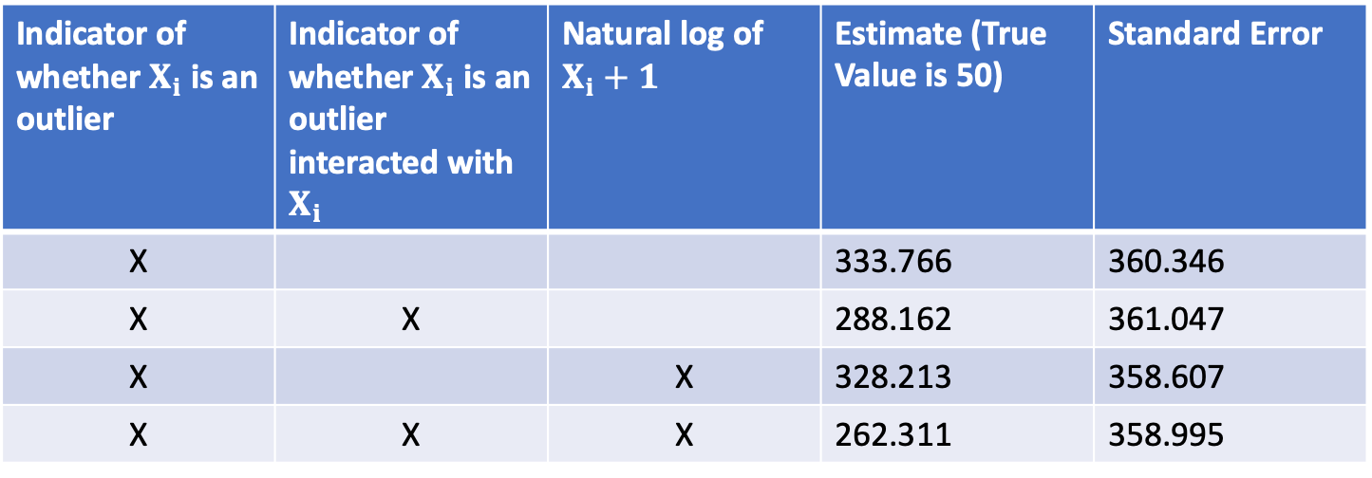
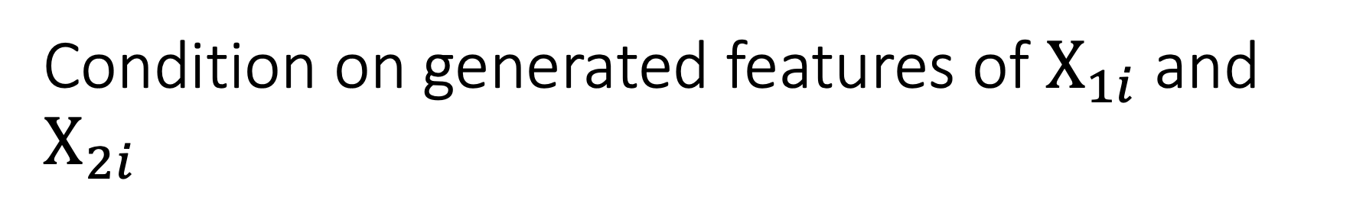
Condition on generated features of $X_{1i}$ and $X_{2i}$
Indicator of whether $X_{i}$ is an outlier | Indicator of whether $X_{i}$ is an outlier interacted with $X_{i}$ | Natural log of $X_{i}+1$ | Estimate (True Value is 50) | Standard Error
X |  |  | 333.766 | 360.346
X | X |  | 288.162 | 361.047
X |  | X | 328.213 | 358.607
X | X | X | 262.311 | 358.995
Conditioning on additional features drives the estimate to be closer to the truth, but at best the estimate is more than 400% larger
There is also no impact on the standard error

Slide 13

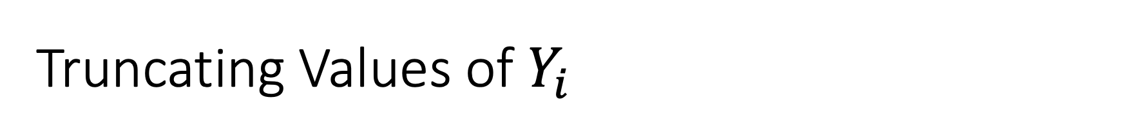
Truncating Values of $Y_{i}$
Truncation is removing observations based on values of $Y_{i}$ .
However, it is unclear how much to truncate. The more data is truncated, the less natural variation in the data is removed.
No principled way to determine the best truncation point.

Slide 14
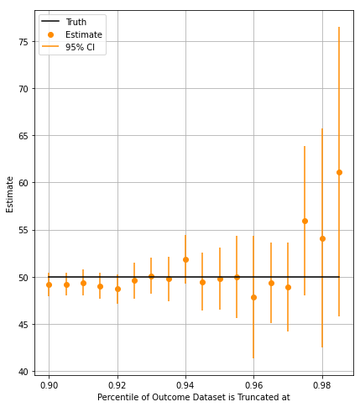
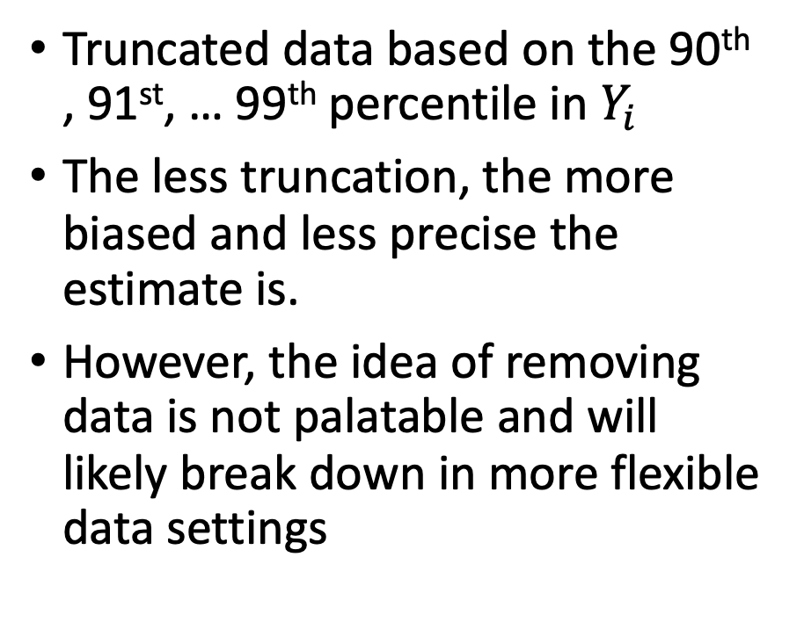
Truncation simulation evidence
Truncated data based on the 90th , 91st, … 99th percentile in $Y_{i}$
The less truncation, the more biased and less precise the estimate is.
However, the idea of removing data is not palatable and will likely break down in more flexible data settings

Slide 15
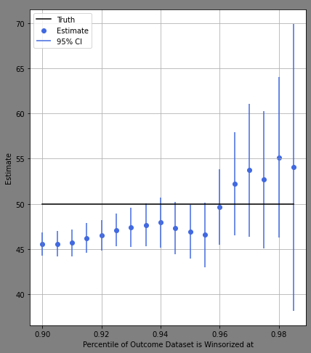
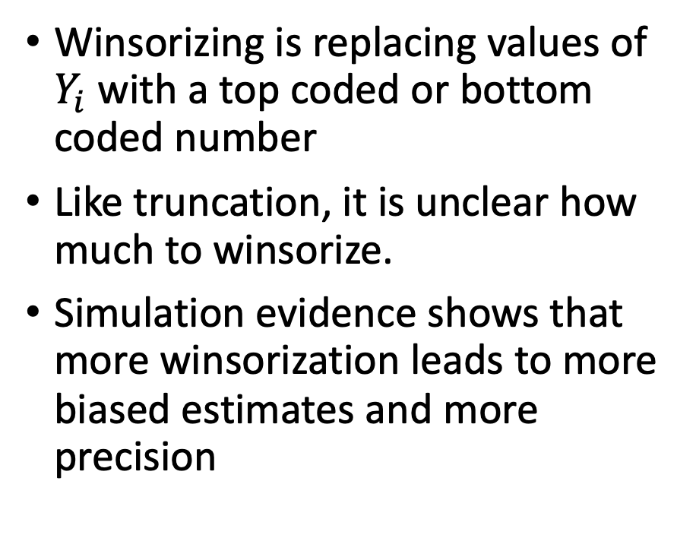
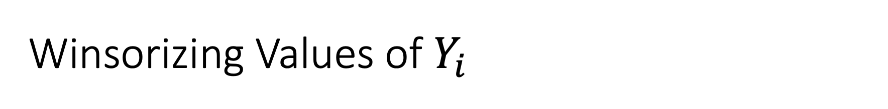
Winsorizing Values of $Y_{i}$
Winsorizing is replacing values of $Y_{i}$ with a top coded or bottom coded number
Like truncation, it is unclear how much to winsorize.
Simulation evidence shows that more winsorization leads to more biased estimates and more precision

Slide 16
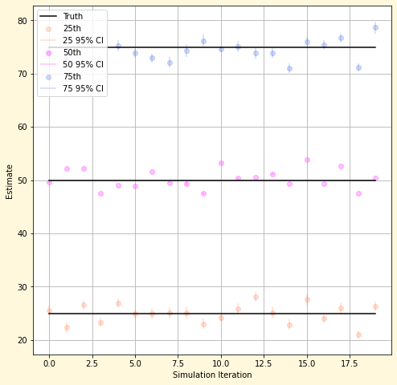
WIP – Median and Quantile Treatment Effects

Slide 17
B. Feature Selection
WIP

Slide 19
C. Bad Control
WIP

Slide 21
D. Propensity Score Trimming
WIP

Slide 23
Appendix

Slide 24
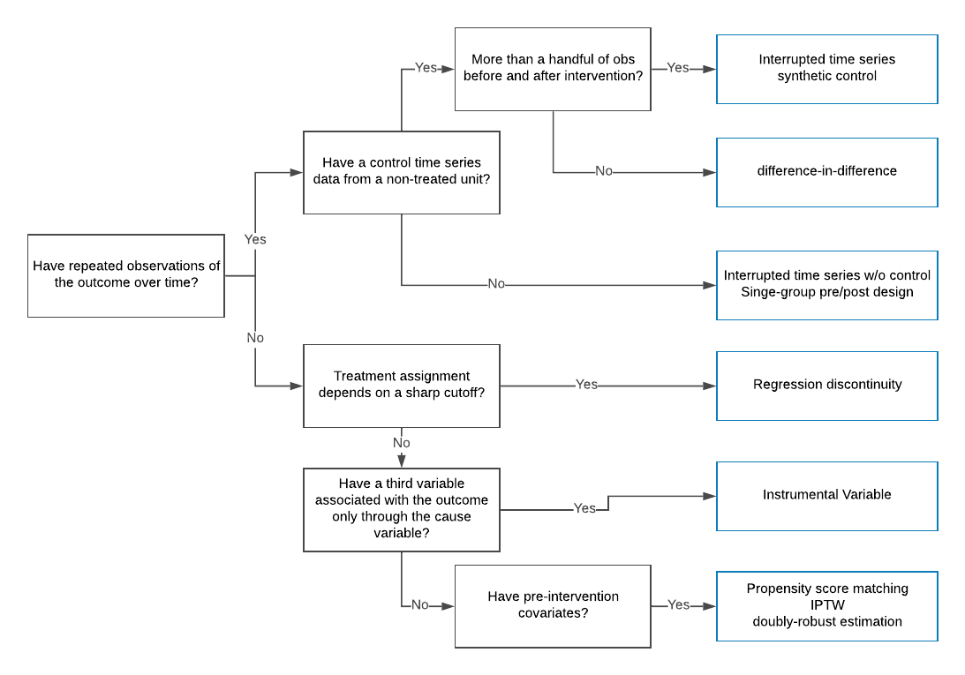
Source: https://eng.uber.com/causal-inference-at-uber/

